Slide 1




CUSTOMER EXPERIENCE AS A MARKETING WEAPON
Rawabi Mohammed Al-otaibi
Layan Salman Al-Awad
Rinad Fahad Al-Sulaiti
Wiam Radhi Al-Anzi
Shatha Fadi Al-Anzi
Dr. Fay Al-Madras.

Slide 2


INTRODUCTION
Customer experience is a powerful marketing weapon that builds loyalty and turns customer satisfaction into brand marketing.

Slide 3


WHAT IS CUSTOMER EXPERIENCE?
Overall impression of the brand
Includes service, communication, and ease of use
Builds trust and long-term relationships

Slide 4
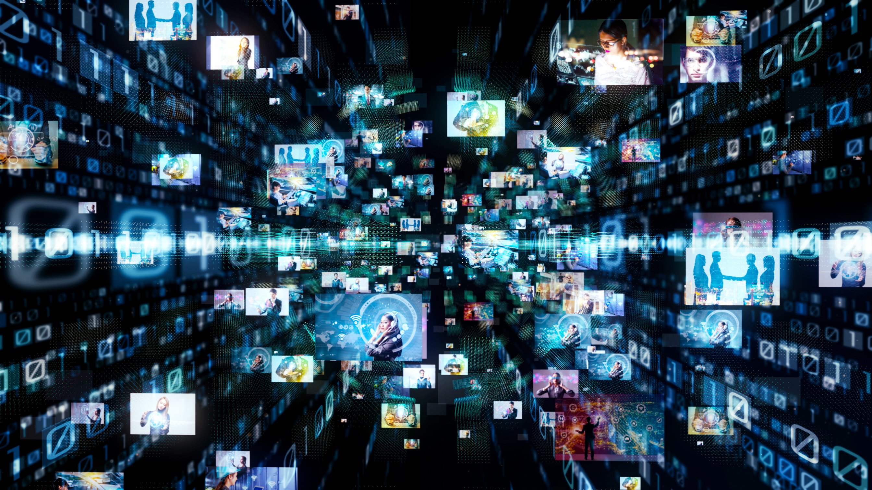
WHY IS CUSTOMER EXPERIENCE IMPORTANT?
Word-of-mouth marketing from customers
Reduces marketing costs.

Slide 5

CUSTOMER EXPERIENCE AS A MARKETING WEAPON
Satisfied customers become promoters
Supports word-of-mouth marketing

Slide 6



ELEMENTS OF CUSTOMER EXPERIENCE
Fast service
Clear communication

Slide 7

HOW CUSTOMER EXPERIENCE AFFECTS PURCHASE DECISIONS
Customers prefer brands that understand them
Emotional reassurance increases buying
A good first experience creates loyalty

Slide 8


POWER OF CUSTOMER EXPERIENCE IN MARKETING
Creates a strong brand identity
Builds deep emotional loyalty
Free marketing through referrals

Slide 9


CHALLENGES
Requires continuous improvement
Hard to maintain consistent quality
Negative experiences spread quickly

Slide 10

EXAMPLE: APPLE
Why Apple Excels:
Easy and intuitive products
Clear and friendly support
Strong emotional connection
Result:
Loyal customers promote the brand automatically.

Slide 11

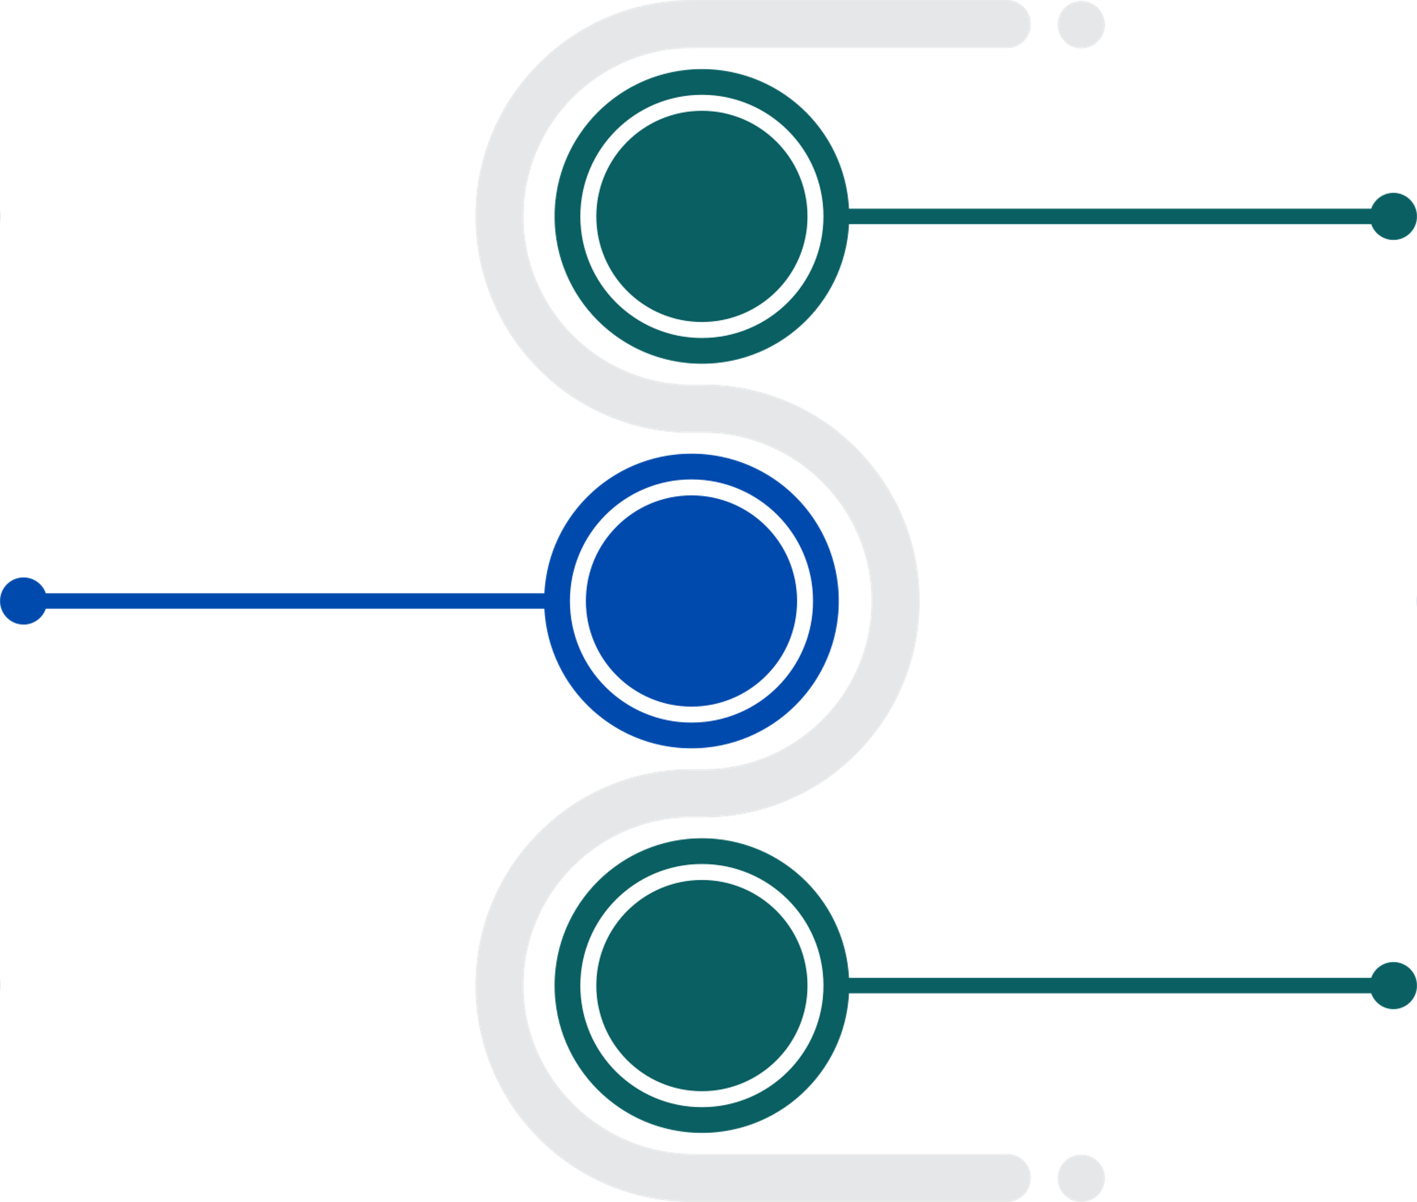

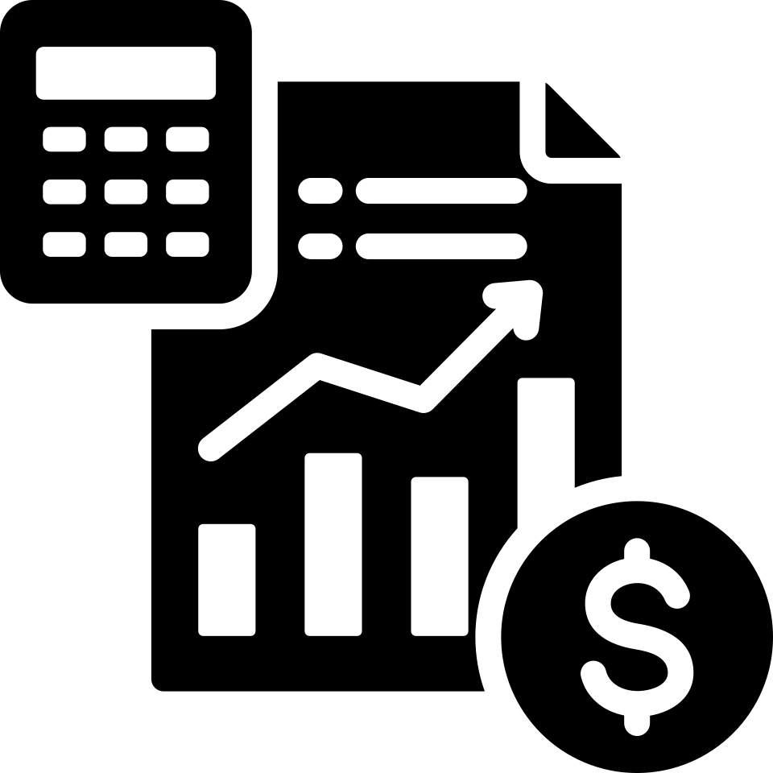


TOOLS TO IMPROVE CUSTOMER EXPERIENCE
Customer satisfaction surveys
Easy-to-use platforms
Fast support

Slide 12


CUSTOMER EXPERIENCE TOUCHPOINTS
Website and apps
Customer service
In-store experience

Slide 13

HOW CUSTOMER EXPERIENCE ADDS BRAND VALUE
Stronger trust
Better reputation
Customer-focused approach

Slide 14

CONCLUSION
Customer experience is a strategic force that gives companies loyalty, growth, and a sustainable marketing advantage.

Slide 15

FINAL THOUGHT
“Excellent customer experience creates satisfaction… loyalty… and long-term success.”
Alexander Aronowitz

Slide 16


THANK YOU

